Slide 1


Lightning talks – PIMPL
Andrei Toader

Slide 2
Lightning talks - Pimpl
Intent:
- Remove compilation dependencies on internal class implementations and improve compile times.
- It comes really handy on large codebases.

Slide 3
Lightning talks - Pimpl
Description:
When a header files changes, any files that #include that file will need to be recompiled.
PIMPL idiom hides private members from any users of the header file, allowing these internal details to change without requiring recompilation of the client code.

Slide 4
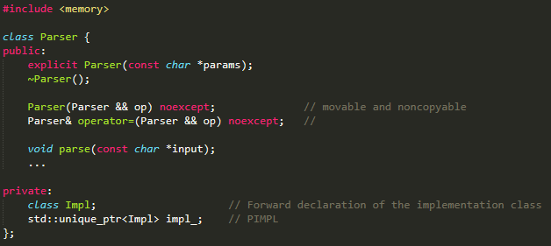
Lightning talks - Pimpl

Slide 5
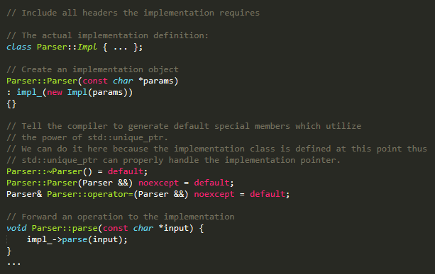
Lightning talks - Pimpl

Slide 6
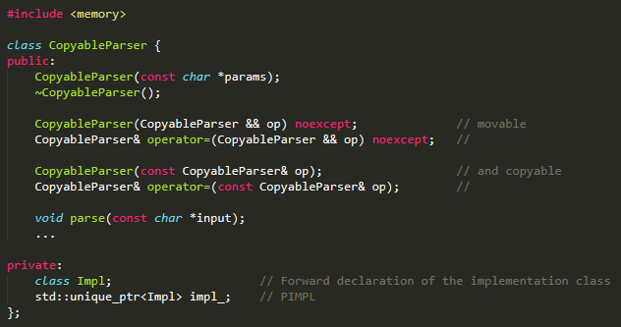
Lightning talks - Pimpl

Slide 7
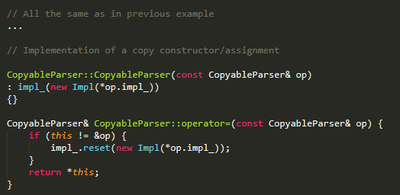
Lightning talks - Pimpl

Slide 8
THANK YOU

